Slide 1
Social determinants of health
L9
2024-2025

Slide 2
Health
The World Health Organization (WHO) defined health as “ A state of complete physical, mental and social wellbeing and not merely the absence of disease or infirmity.
Wellbeing
Well-being is a positive state experienced by individuals and societies. Similar to health, it is a resource for daily life and is determined by social, economic and environmental conditions

Slide 3
What are the social determinants of health ?
According to World Health Organization (WHO)
The social determinants of health (SDH) are the non-medical factors that influence health outcomes. They are the conditions in which people are born, grow, work, live, and age, and the wider set of forces and systems shaping the conditions of daily life. These forces and systems include economic policies and systems, development agendas, social norms, social policies and political systems.

Slide 4
The SDOH have an important influence on health inequities - the unfair and avoidable differences in health status seen within and between countries.
In countries at all levels of income, health and illness follow a social gradient: the lower the socioeconomic position, the worse the health.
Addressing SDOH appropriately is fundamental for improving health and reducing longstanding inequities in health, which requires action by all sectors and civil society.

Slide 5
The following list provides examples of the social determinants of health, which can influence health equity in positive and negative ways:
Income and social protection
Education
Unemployment and job insecurity
Working life conditions
Food insecurity
Housing, basic amenities and the environment
Early childhood development
Social inclusion and non-discrimination
Structural conflict
Access to affordable health services of decent quality.

Slide 6
Social Determinants of Health at CDC
Centers for Disease Control and Prevention (CDC) has adopted the SDOH definition from the World Health Organization.
SDOH are one of three priority areas for Healthy People 2030, along with health equity and health literacy.

Slide 7
Social Determinants of Health in Healthy People 2030
Social determinants of health (SDOH) can be grouped into 5 domains:
Economic Stability
Education Access and Quality
Health Care Access and Quality
Neighborhood and Built Environment
Social and Community Context

Slide 8
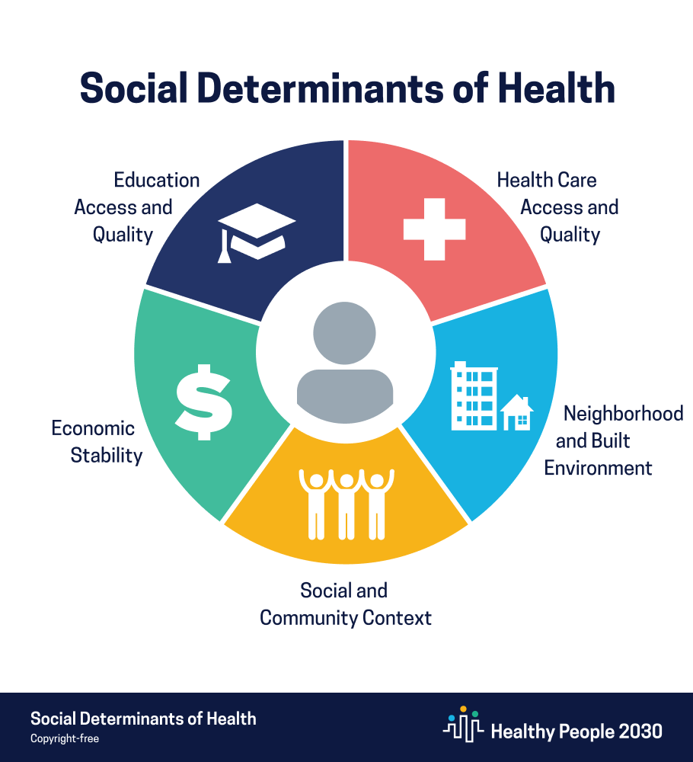

Slide 9
1- Economic Stability : This refers to the link between a person’s finances and their health. Examples of factors are:
Employment
Food Insecurity
Housing Instability
Poverty

Slide 10
2- Education Access and Quality This category focuses on the connection between a person’s access to education and its quality, and their health. Examples include:
Early Childhood Development and Education
Enrollment in Higher Education
High School Graduation
Language and Literacy

Slide 11
3- Health Care Access and Quality This group encompasses a person’s access to healthcare and its quality. Factors include:
Access to Health Services
Access to Primary Care
Health Literacy

Slide 12
4- Neighborhood and Built Environment: This group considers a person’s housing and environment and the role they play in the person’s health. Factors include:
Access to Foods That Support Healthy Dietary Patterns
Crime and Violence
Environmental Conditions
Quality of Housing

Slide 13
5- Social and Community Context: This group revolves around the ways a person lives, works, plays, and learns and how these relate to the person’s health. Factors include:
Civic Participation
Discrimination
Incarceration
Social Cohesion

Slide 14
Quiz
1- define health, wellbeing , social determinants of health
2- what are the main social determinant of health

Slide 15
Thank you

